Slide 1
Road traffic safety
Tasmali Sergiu

Slide 2
What is Road Safety?
Road traffic safety refers to the methods and measures used to prevent road users from being killed or seriously injured. Typical road users include pedestrians, cyclists, motorists, vehicle passengers, horse riders, and passengers of on-road public transport (mainly buses and trams).

Slide 3
What are the road safety rules?
Never Drink & Drive.
Always Wear Seat Belt.
Keep a Safe Distance from the vehicle ahead.
Always Avoid Distractions.
Never Break Red Signal.
Always Drive Within Speed Limit.
Avoid the Drowsiness While Driving.
Watch Out For Drivers On the Road.

Slide 4
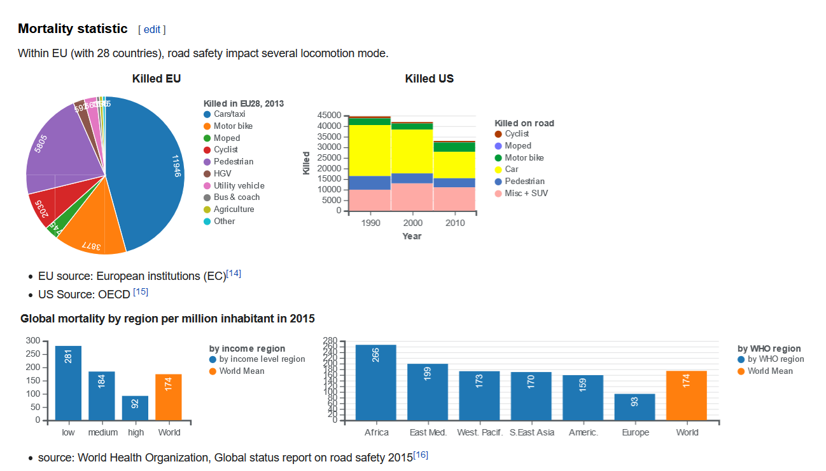
Some Statistics

Slide 5
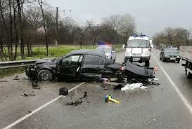
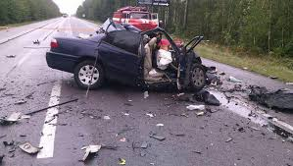
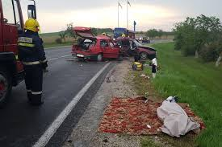
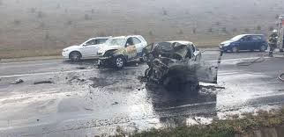
Photos

Slide 6
Tanks for watching

